Slide 1

Lecture: Java ML
Topics: Basics of ML, Using JavaML in Android

Slide 2
What is Machine Learning?
The ability of computers to learn rules from data.
A Math Equation That We Don’t Know
X1
Y
X2

Slide 3
What is Machine Learning?
The ability of computers to learn rules from data.
Can you guess the function given the input-output data?
Example #1:
A Math Equation That We Don’t Know
X1 | X2 | Y
3 | 4 | 12
5 | 2 | 10
10 | 3 | 30
X1
Y
X2
Answer: Y = X1 * X2

Slide 4
What is Machine Learning?
The ability of computers to learn rules from data.
Can you guess the function given the input-output data?
Example #2:
A Math Equation That We Don’t Know
X1 | X2 | Y
10 | 2 | 12
5 | 2 | 7
8 | 2 | 10
X1
Y
X2
Answer: Y = X1 + X2

Slide 5
What is Machine Learning?
The ability of computers to learn rules from data.
Can you guess the function given the input-output data?
Example #3:
A Math Equation That We Don’t Know
X1 | X2 | Y
10 | 2 | 12
5 | 2 | 7
8 | 2 | 10
5 | 3 | 6
X1
Y
X2
Answer: Y = X1 - X2 + 4

Slide 6
What is Machine Learning?
Often in machine learning, the output is +1 or -1. We may want to call it a “Classification” problem
X1 | X2 | Y
170 | 137 | +1
165 | 145 | +1
120 | 2000 | -1
127 | 2200 | -1
A Function/Mapping That We Don’t Know
X1
Y
X2
if (X1 <= 127 && X2 >= 2000) {
Y = -1;
}
else if (X1 <= 170 && X2 <= 145){
Y = +1;
}

Slide 7
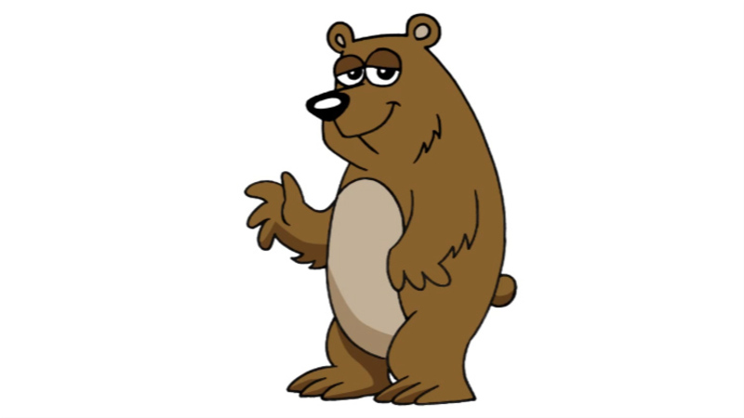

An Example Classification Problem
A real classification problem: Bear vs. Buffalo

Slide 8
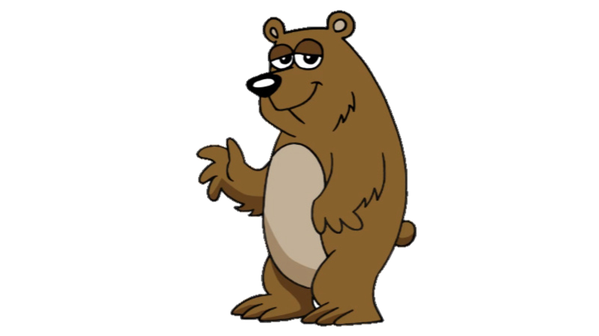
An Example Classification Problem
A real classification problem: Bear vs. Buffalo
Height X1 (cm) | Weight X2 (lb) | Class
170 | 137 | Bear
165 | 145 | Bear
120 | 2000 | Buffalo
127 | 2200 | Buffalo

Slide 9
An Example Classification Problem
A real classification problem: Bear vs. Buffalo
Height X1 (cm) | Weight X2 (lb) | Class
170 | 137 | Bear
165 | 145 | Bear
120 | 2000 | Buffalo
127 | 2200 | Buffalo
if (X1 <= 127 && X2 >= 2000) {
Y = -1; //Buffalo
}
else if (X1 <= 170 && X2 <= 145){
Y = +1; //Bear
}
Why do we want to learn these rules?

Slide 10
Two Phases of Machine Learning
Learning/Training Phase:
Applying/Testing Phase:
Height X1 (cm) | Weight X2 (lb) | Class
170 | 137 | Bear
165 | 145 | Bear
120 | 2000 | Buffalo
127 | 2200 | Buffalo
if (X1 <= 127 && X2 >= 2000) {
Y = -1; //Buffalo
}
else if (X1 <= 170 && X2 <= 145){
Y = +1; //Bear
}
Height X1 (cm) | Weight X2 (lb) | Class
120 | 2300 | ?
160 | 100 | ?

Slide 11
Two Phases of Machine Learning
Learning/Training Phase:
Applying/Testing Phase:
features
Class Label
X₁ | X₂ | … | X_{N} | Y
Model
Instance
Training Set
X₁ | X₂ | … | X_{N} | Y
Test Set

Slide 12
Machine Learning with Android
We will download and use JavaML library
To setup the library in Android Studio:
http://java-ml.sourceforge.net/
https://stackoverflow.com/questions/25660166/how-to-add-a-jar-in-external-libraries-in-android-studio
Add your jar file to app/libs folder (if there is no libs folder you can create it), and then right click the jar file and click "add as library“

Slide 13
Creating a Dataset (e.g. for training)
Create Instances:
Add Instances to Dataset:
Double[] row1 = new double[] {170.0, 137.0};
Double[] row2 = new double[] {165.0, 145.0};
Double[] row3 = new double[] {120.0, 2000.0};
Double[] row4 = new double[] {127.0, 2200.0};
Instance example1 = new DenseInstance (row1, ”bear”);
Instance example1 = new DenseInstance (row2, ”bear”);
Instance example1 = new DenseInstance (row3, ”buffalo”);
Instance example1 = new DenseInstance (row4, ”buffalo”);
Dataset dset = new DefaultDataset();
dset.add(example1);
dset.add(example2);
dset.add(example3);
dset.add(example4);

Slide 14
Creating a Classifier (model)
Creating a classifier:
Add Instances to Dataset:
Classifier knn = KNearestNeighbors(3);
knn.buildClassifier(dset);
double unknown = new double[] {120.0, 2300.0};
Instance unknown_example = new Instance(unknown);
Object result = knn.classify(unknown_example);

